Slide 1

Computational Physics (PHYS6350)
Lecture 20: Problems in statistical physics part II
Simulated annealing
Percolation simulation
April 6, 2023
Instructor: Volodymyr Vovchenko (vvovchenko@uh.edu)
Course materials: https://github.com/vlvovch/PHYS6350-ComputationalPhysics

Slide 2
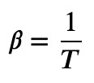
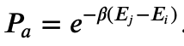
Finding the ground state
Recall how in Metropolis algorithm we move between states
For a move from state i to state j
If E_{j}<E_{i}, the move is unconditionally accepted.
If E_{j}>E_{i}, the move is accepted with a probability
At T = 0 only the single ground state E_{i} = 0 contributes to the partition function, however, finding this state directly may be challenging (too long equilibration, have to probe a lot of states, can end up in a local minimum)
Alternative approach:
Start at some finite T
Run the Metropolis algorithm to reach equilibrium
Lower the temperature a bit and run the Metropolis algorithm to reach new equilibrium
Repeat until T = 0 where we will reach the ground state

Slide 3
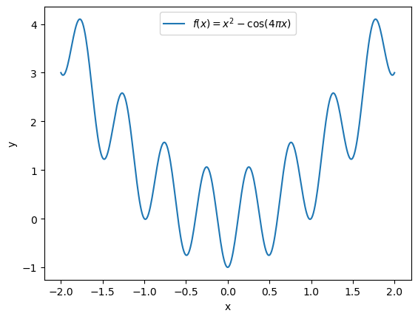
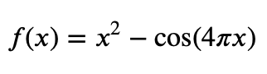
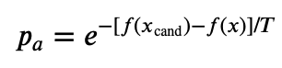
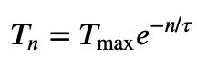
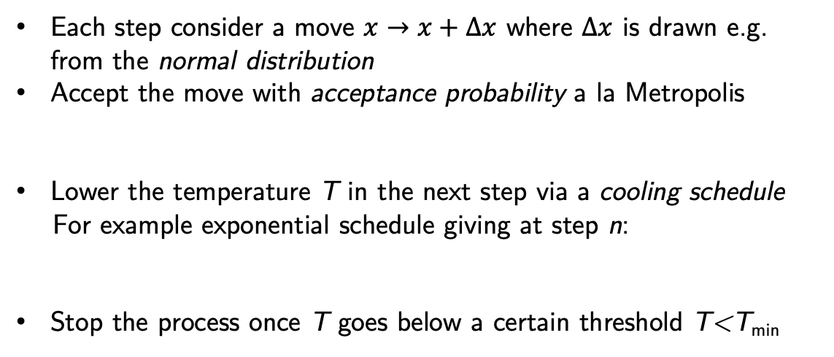
Simulated annealing
Apply this logic to find the global minimum of a function f(x)
Helps avoid getting stuck in a local minimum
Example:
Each step consider a move $x→x+∆x$ where $∆x$ is drawn e.g. from the normal distribution
Accept the move with acceptance probability a la Metropolis
Lower the temperature T in the next step via a cooling schedule
For example exponential schedule giving at step n:
Stop the process once T goes below a certain threshold T<T_{min}

Slide 4
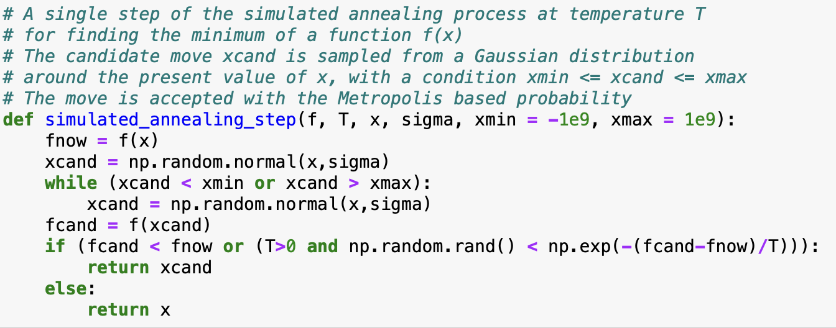
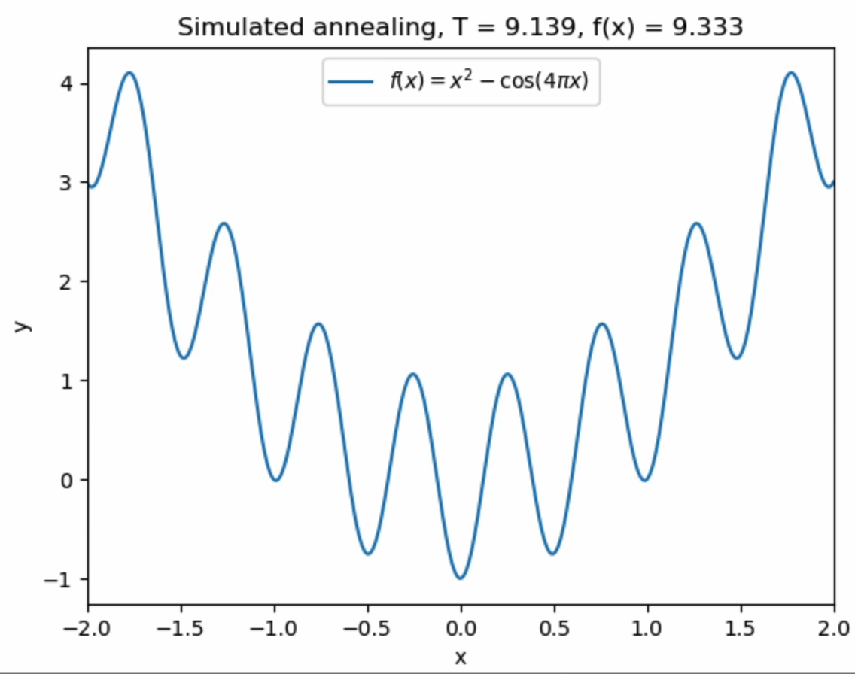
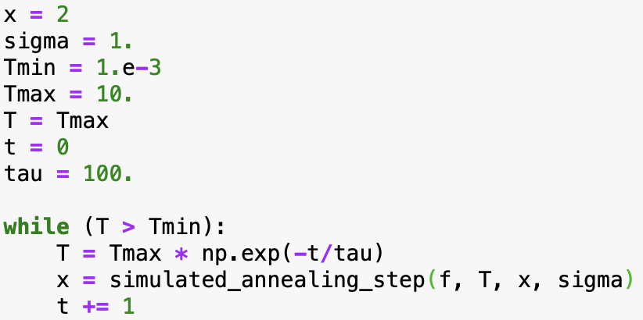
Simulated annealing
Apply it to our function

Slide 5
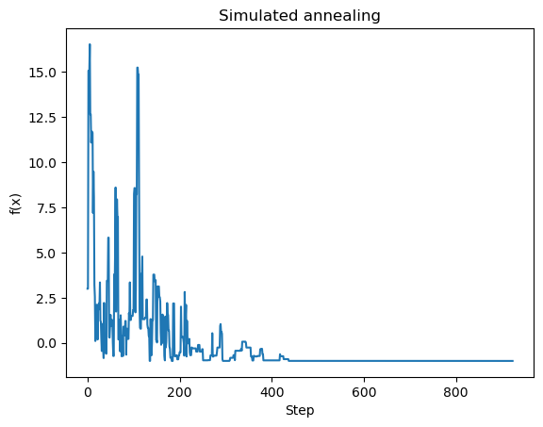
Simulated annealing
Apply it to our function

Slide 6
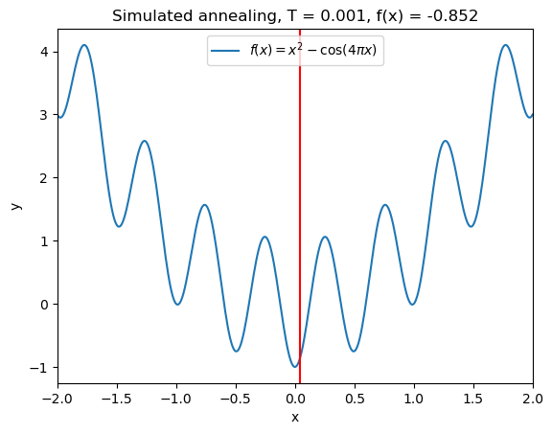
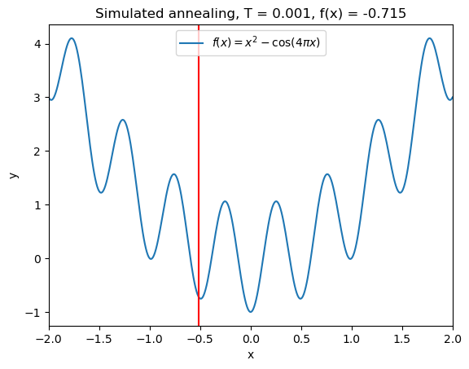

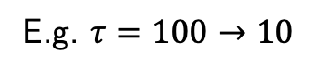
Simulated annealing
The solution is approximate and not guaranteed to give the global minimum, especially if cooling is too fast
E.g. $τ=100→10$
Run 1
Run 2
Run 3
The choice of possible moves, acceptance probabilities, and cooling schedule should be varied and tailored for the problem at hand

Slide 7
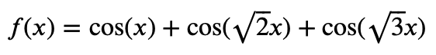
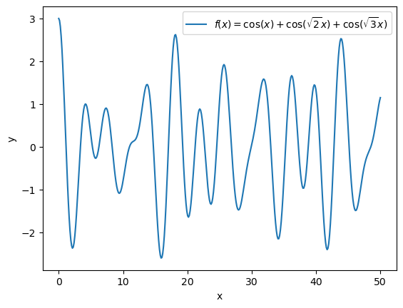
Simulated annealing
A more involved example

Slide 8
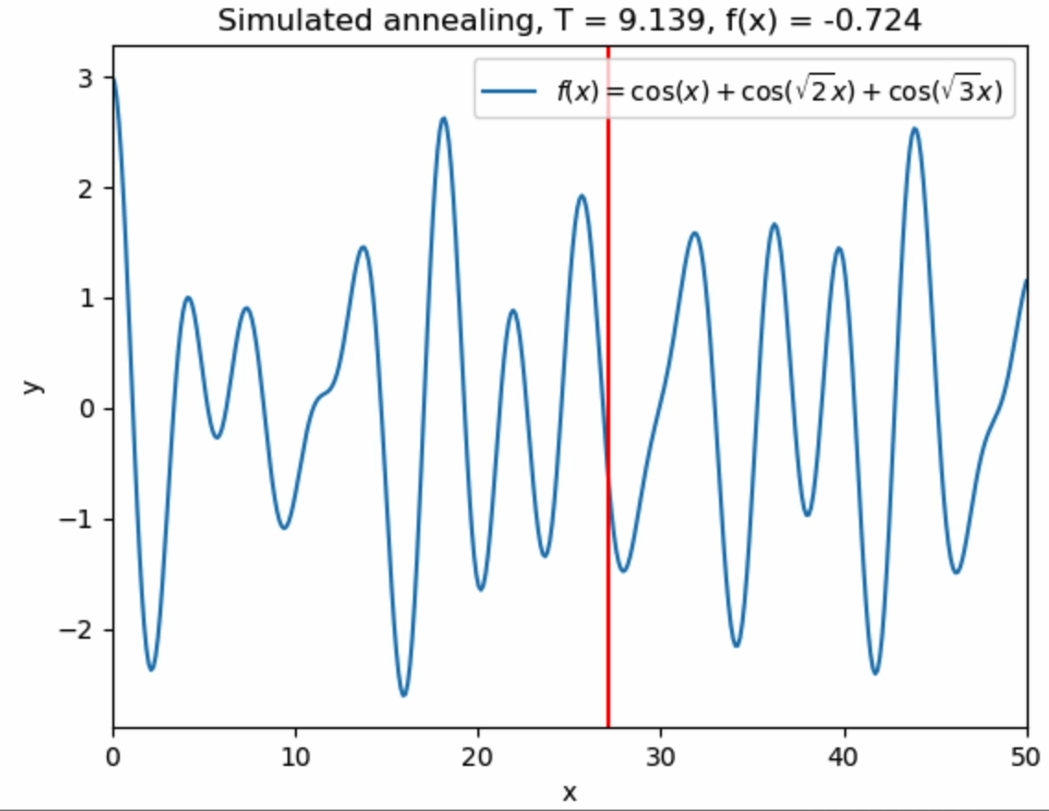
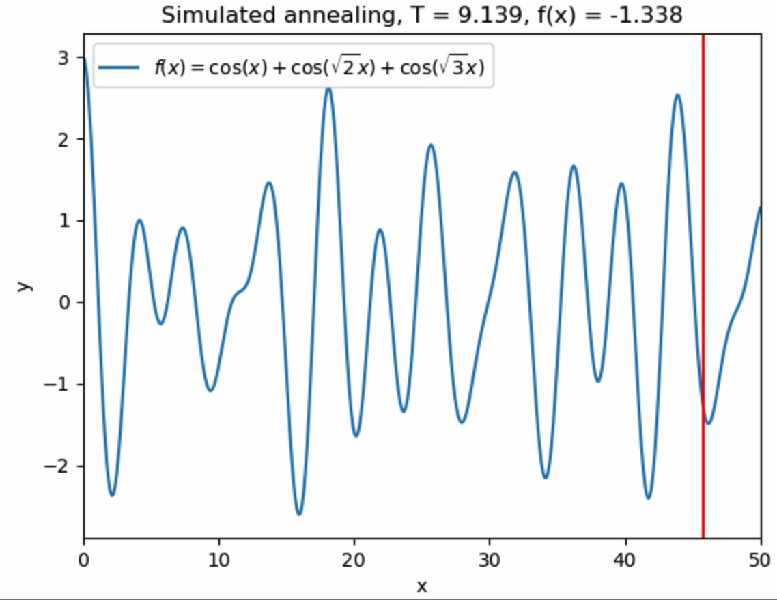
Simulated annealing
A more involved example

Slide 9
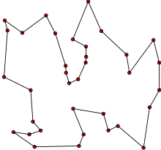
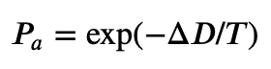
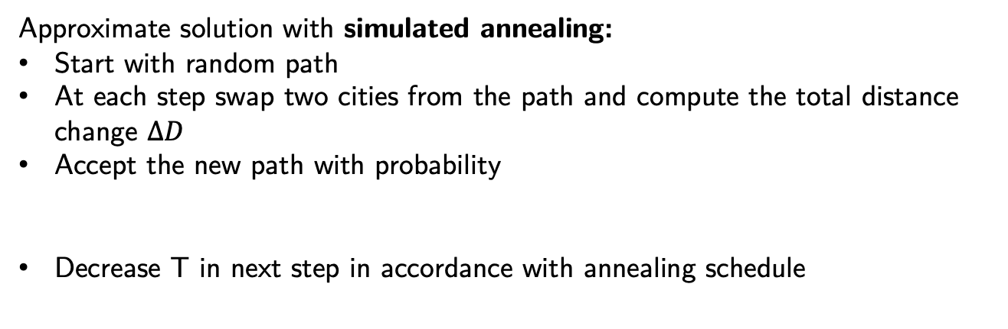
Simulated annealing and the traveling salesman problem
Traveling salesman problem (TSP):
You have N cities where each pair of cities is connected by roads.
You need to visit all cities exactly once starting ending the trip in the starting city.
The goal is to find a path with the shortest total distance to travel.
The traveling salesman problem in NP-hard
Known exact solutions are exponential in N
Credit: Wikipedia
Brute-force: O(N!)
Held-Karp algorithm: O(N² 2^{N})
Approximate solution with simulated annealing:
Start with random path
At each step swap two cities from the path and compute the total distance change $∆D$
Accept the new path with probability
Decrease T in next step in accordance with annealing schedule

Slide 10
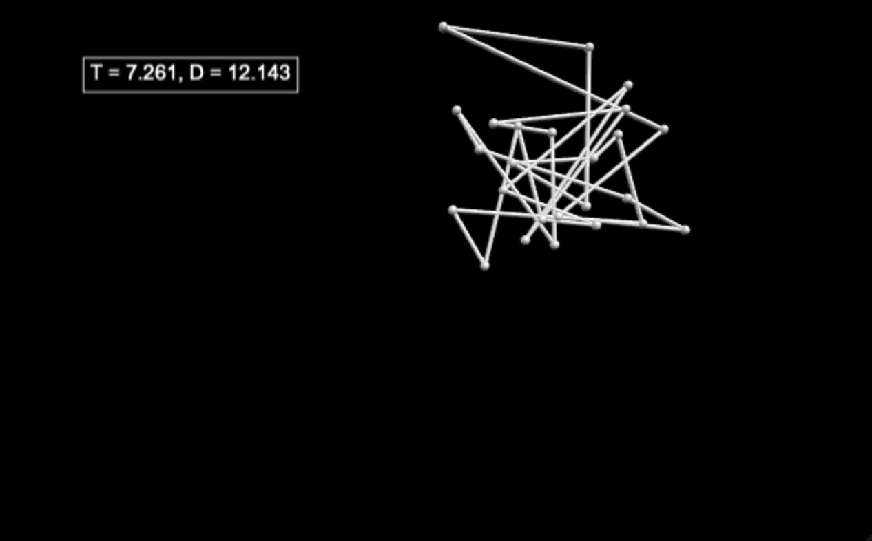
Simulated annealing and the traveling salesman problem
Code adapted from Example 10.4 from M. Newman, Computational Physics, http://www-personal.umich.edu/~mejn/cp/programs/salesman.py

Slide 11
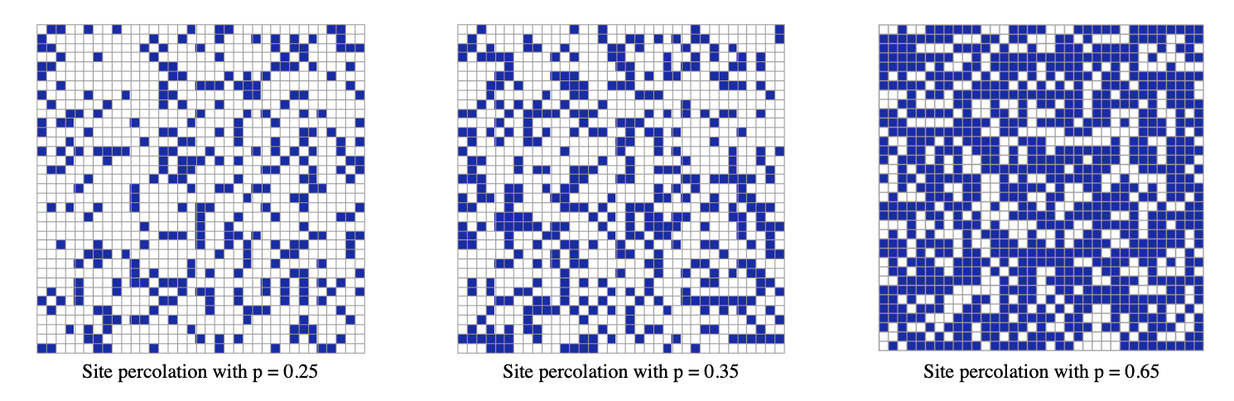
Percolation threshold
Percolation theory studies the formation of long-range connectivity in random systems.
Usually, one can imagine a geometric configuration where certain “conducting” objects occupy
a fraction of space
Example: square lattice
Some fraction p of sites is occupied
Occupied sites form clusters through connection to its four neighbors
Above certain p_{c}, and long-range, ”infinite” cluster forms
insulator
insulator
conductor
From https://faculty.math.illinois.edu/~kkirkpat/percolation.html

Slide 12
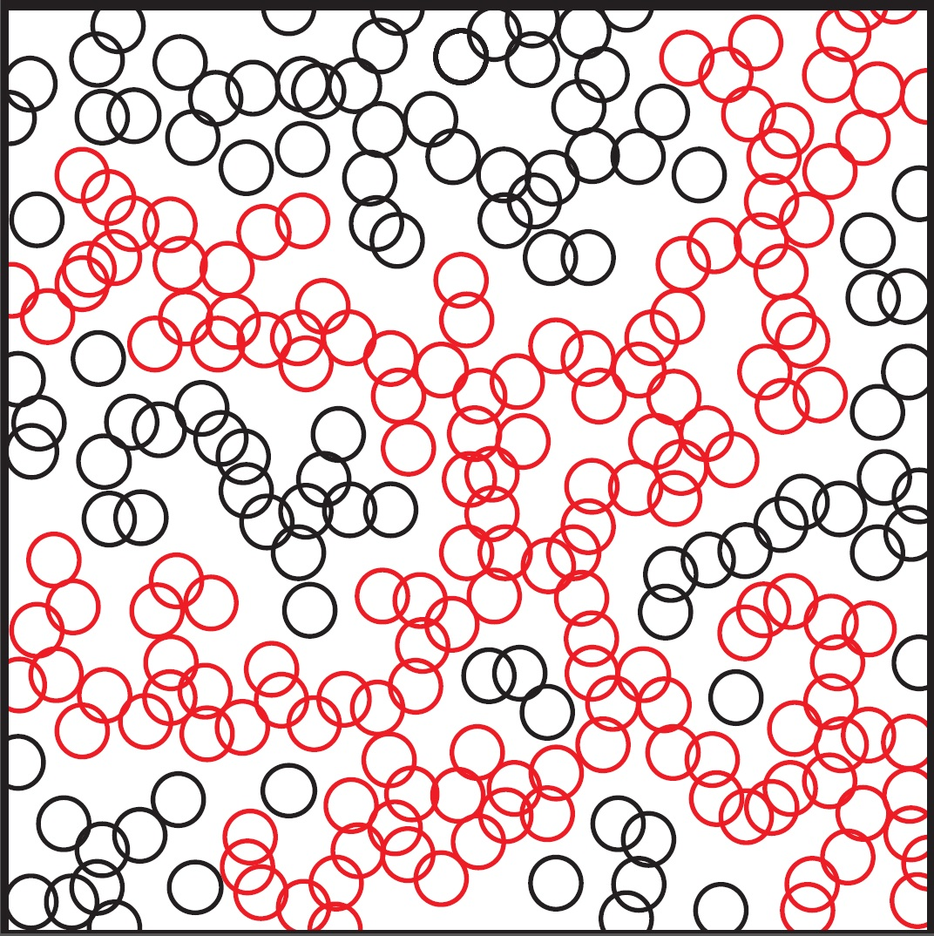
Percolation threshold
Example: square lattice
Another example:
disk percolation
insulator
insulator
conductor
From https://faculty.math.illinois.edu/~kkirkpat/percolation.html
Above a percolation threshold p_{c} connectivity across the whole grid forms, insulator -> conductor
How to find p_{c}?
How to find p_{c}?

Slide 13
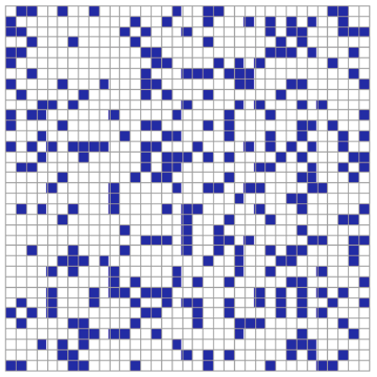
Percolation threshold simulation
Simulate percolation threshold with Monte Carlo methods
Strategy 1:
For a given value of p mark each site as occupied with probability p
Find all clusters (e.g. with union-find data structure)
Check if a conducting cluster from bottom to top edge exists
We expect the cluster to exists for p>p_{c} and not exist for p<p_{c}
Strategy 2:
Start with zero occupied site
Mark a random unoccupied site as occupied and check if it forms a new cluster
Repeat the process until a conducting cluster is formed
The ration of occupied to total sites is the estimate for p_{c}
Caveats: finite-size effects
How to find p_{c}?

Slide 14
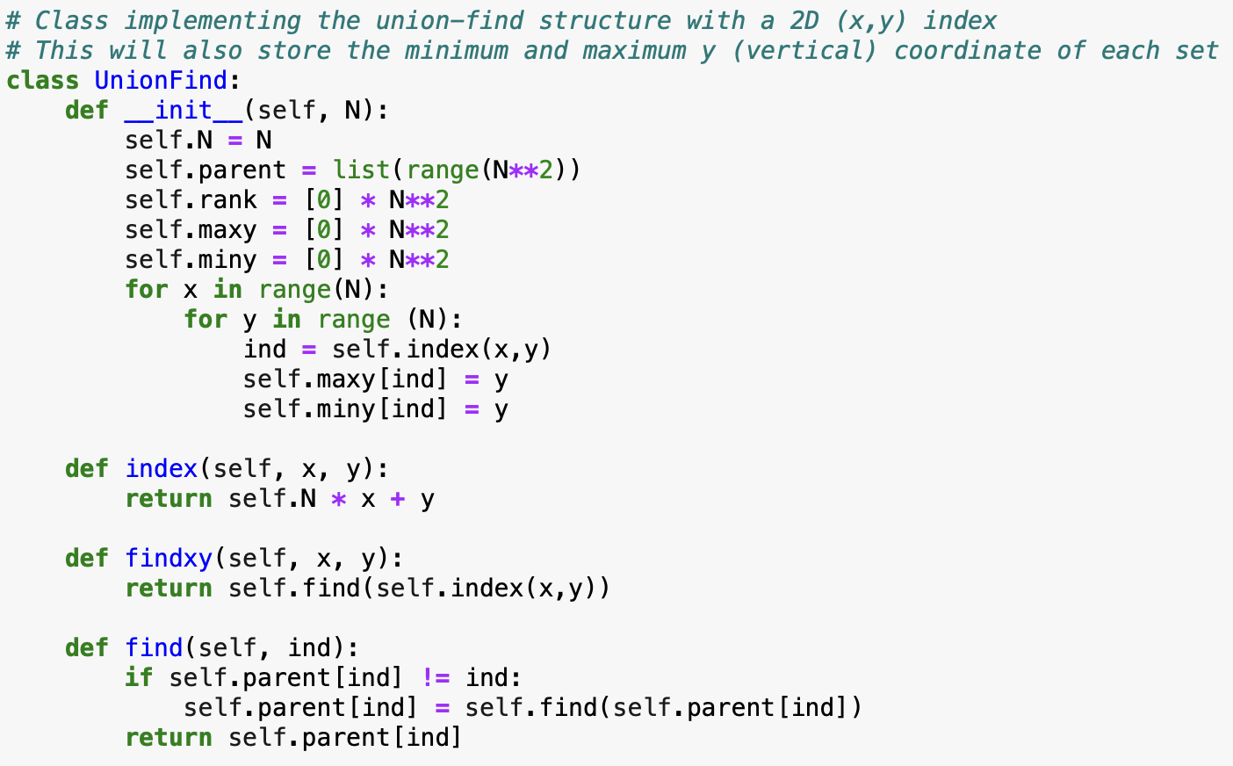
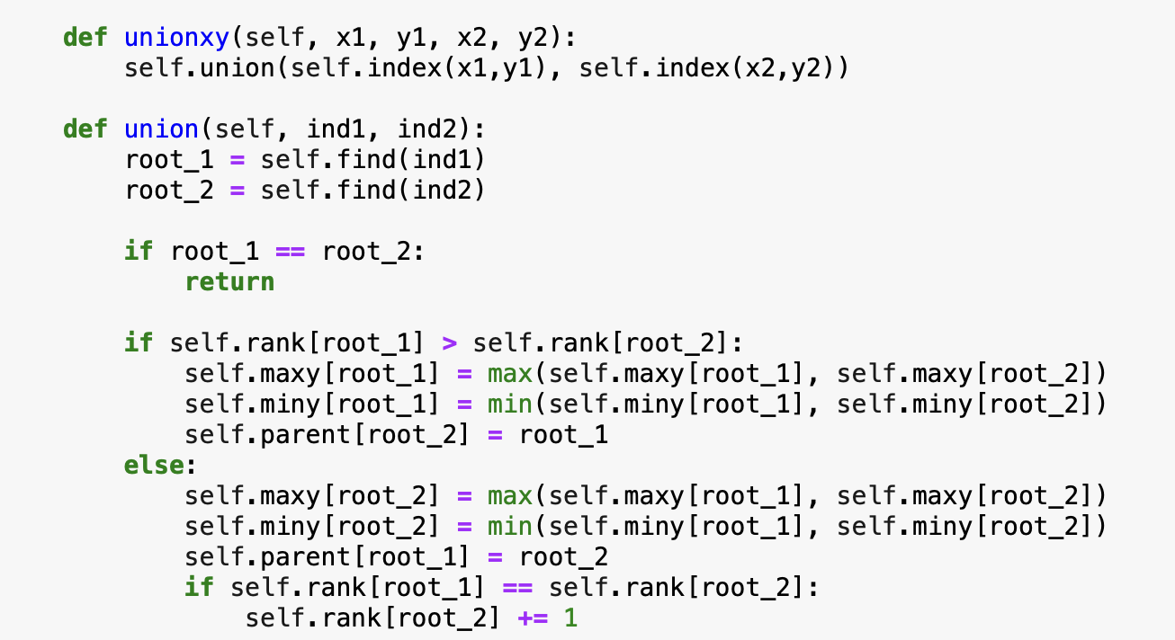
Percolation threshold: union-find data structure
For finding clusters we can utilize the union-find data structure
Here implemented for a 2D grid, and keeps track of max and min y coordinate
How to find p_{c}?

Slide 15
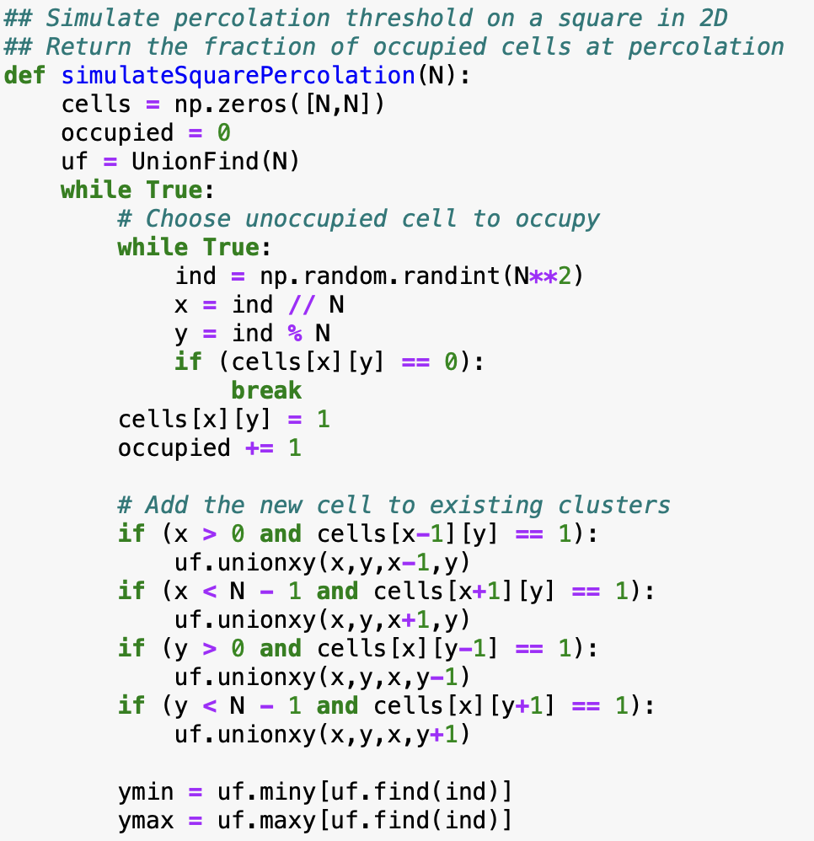
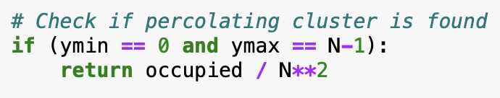
Percolation threshold: implementing strategy 2
How to find p_{c}?

Slide 16
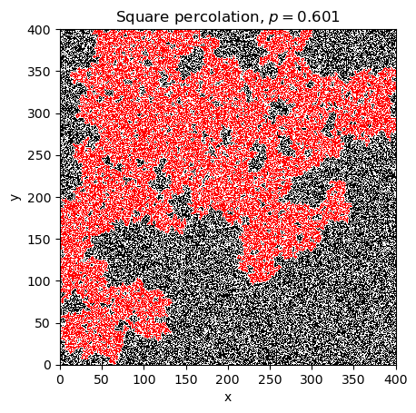
Percolation threshold: implementing strategy 2
N = 400:
How to find p_{c}?

Slide 17
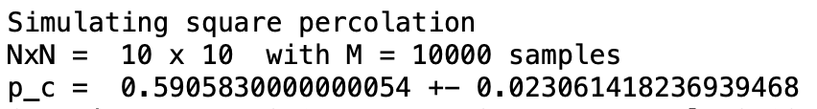
Percolation threshold: implementing strategy 2
N = 400:
10000 runs with N = 10:
Literature value:
p_{c} = 0.592746
How to find p_{c}?

